Slide 1
Personal Finance Dashboard - Power BI
Yvonne Makena

Slide 2
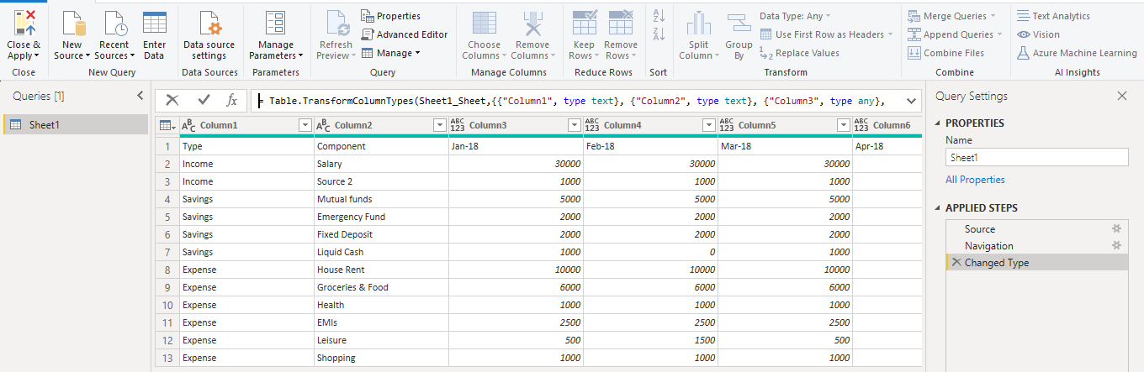
Import the data
On the PowerBI Dashboard
Home Tab - Get Data - Excel Workbook - Connect - Select your excel file - Open - Check the name of the Database (In our case Sheet1) - Transform Data
This will open a power query window

Slide 3
Transforming the Data
Select Top Row as the header row
Drop down menu before column 1 - Use first row as headers
Rename column Feb-21 to Aug-21
Double click and rename format same as the previous columns
Convert the dates into a column
Select all dates - Transform - Unpivot Columns

Slide 4
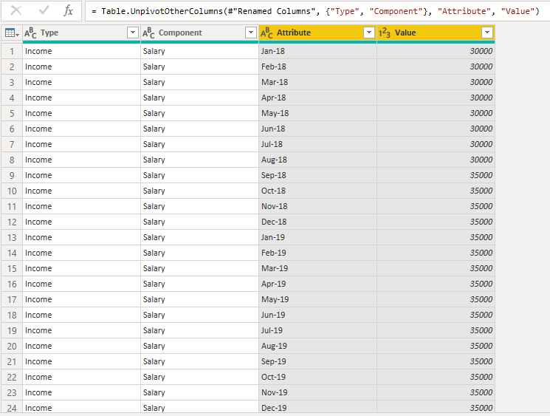
You now have 4 columns

Slide 5
Rename “Attribute” column to “Date”
Change value column data type
Select left side of value column header - select fixed decimal number
Add year column
Change column type to date
Click on “Add column” tab on the menu bar - Date - Year - Year
Change column type to tex
Apply changes
Home Tab - Close & Apply

Slide 6
Build Visuals with the data - Mock the dashboard
MAIN TITLE
Timeline selection (years and months)
KPIs(Networth, Income, savings and expense %)
Expense %, Savings % with change in income MOM %
Alltime: KPIs(Networth, Income, savings and expense %)
Detailed Statement
Expense breakdown %
Savings breakdown %

Slide 7
Build Visuals with the data
KPIs(Networth, Income, savings and expense %)
Create separate folders for all the formulas
Click on the data name “Sheet 1” on the right side
Home Tab - Enter Data - Name the table to “Key Measures” - Load
Right click on the data name “Key Measures” on the right side and select new measure
Change the “measures=” to “Value = SUM(Sheet1[Value])”
Right click on the data name “Key Measures” on the right side and select new measure
Change the “measures=” to “Total Income = CALCULATE(SUM(Sheet1[Value]), Sheet1[Type] = "Income")”
This will specify the summing only the income rows.
Click report icon to the left then drag and drop the Total Income measure. Specify “Card” in visualizations to the right.

Slide 8
Right click on the data name “Key Measures” on the right side and select new measure
Change the “measures=” to “Total Savings = CALCULATE(SUM(Sheet1[Value]), Sheet1[Type] = "Savings")”
This will specify the summing only the savings rows.
Right click on the data name “Key Measures” on the right side and select new measure
Change the “measures=” to “Total Expense = CALCULATE(SUM(Sheet1[Value]), Sheet1[Type] = "Expense")”
This will specify the summing only the Expense rows.
Right click on the data name “Key Measures” on the right side and select new measure
Change the “measures=” to “Savings % = DIVIDE([Total Savings], [Total Income]) ”
Right click on the data name “Key Measures” on the right side and select new measure
Change the “measures=” to “Expense % = DIVIDE([Total Expense], [Total Income]) ”

Slide 9
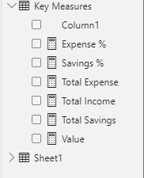
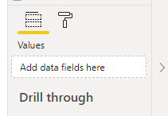

Copy and paste the already created visualization. For each visualization, drag and drop the desired data field into the “Add data fields here” section so that it displays the correct data
Output

Slide 10
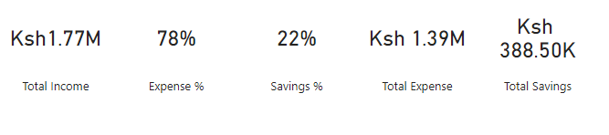
Add text boxes to label the output
Insert - Tex box - Add name and formatting accordingly

